Slide 1
Lab 5 Solutions

Slide 2
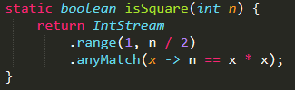
2: Square Numbers
n = 16
1
2
3
4
5
6
7
8
1
2
3
4
5
6
7
8
range
anyMatch

Slide 3
2: Square Numbers
n = 16
1
2
3
4
5
6
7
8
1
2
3
4
5
6
7
8
range
anyMatch
false
true

Slide 4
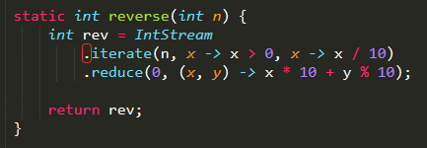
3: Reverse
Loop condition
n = 1234
Initial value
Next value
x
y
1234
123
12
1
[0]
0
4
43
432
1234
123
12
1
4321
Initial value
Reduction logic
iterate
reduce
Next value
Value after prev. loop

Slide 5
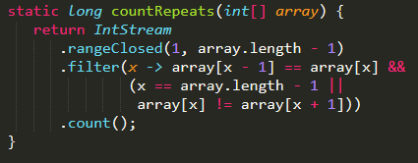
4: Counting Repeats
array[x-1] == array[x] &&
( x == array.length-1 || array[x] != array[x+1] )
Keep x if there is a repeat and
X is not in the middle of a repeated sequence
Can access int array, not limited to streams
…, 1, 1, 1, …, 2, 2
Repeats:
0
1
2

Slide 6

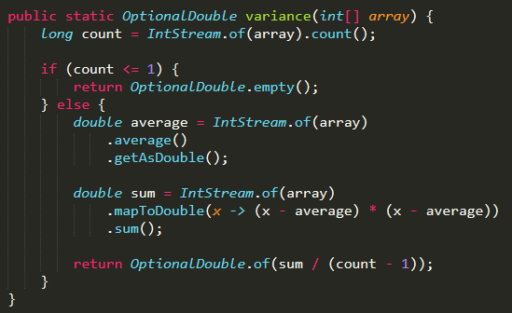
5: Variance
Average
( ) Sum
Cannot divide by 0

Slide 7
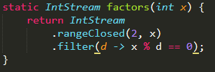


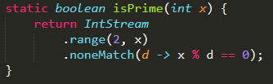
6: Prime Factors

